Slide 1
THE CONTRIBUTION OF BODY CENTER OF MASS VELOCITY TO BASKETBALL BALL RELEASE VELOCITY ACROSS SHOT DISTANCES
Casey Wiens¹ and Jill L. McNitt-Gray^{1,2} Departments of Biological Sciences¹ and Biomedical Engineering² University of Southern California Los Angeles, United States of America

Slide 2
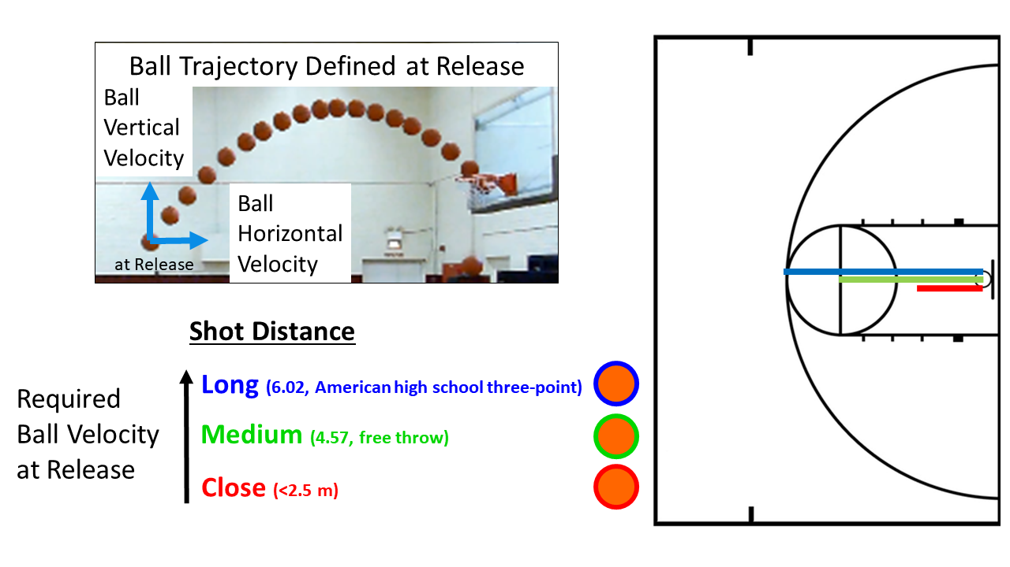
Mechanical Objectives of a Basketball Shot
Likelihood of Success
Ball position relative to hoop
Ball velocity at release
More than one trajectory can result in success from same position
Ball velocity at release is determined by (Hay, 1978):
Body center of mass velocity
Velocity of ball relative to the body center of mass
Contributed to the arms
Center of mass vertical velocity increases with increase in shot distance
Miller and Bartlett, 1993
Okazaki and Rodacki, 2012

Slide 3
Does the Increase in Center of Mass Velocity Reduce the Arm’s Contribution to Ball Velocity?

Slide 4
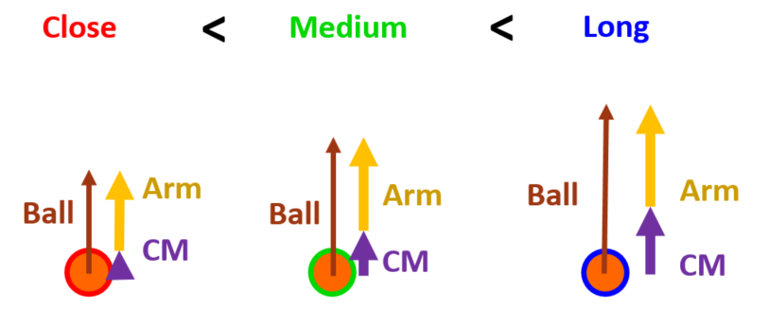
Study Details
Aim
Contribution of Center of Mass (CM) Velocity to Ball Velocity at Release across Distances
Hypothesis
The greater the CM velocity at release, the greater % contribution CM velocity to ball velocity at release

Slide 5
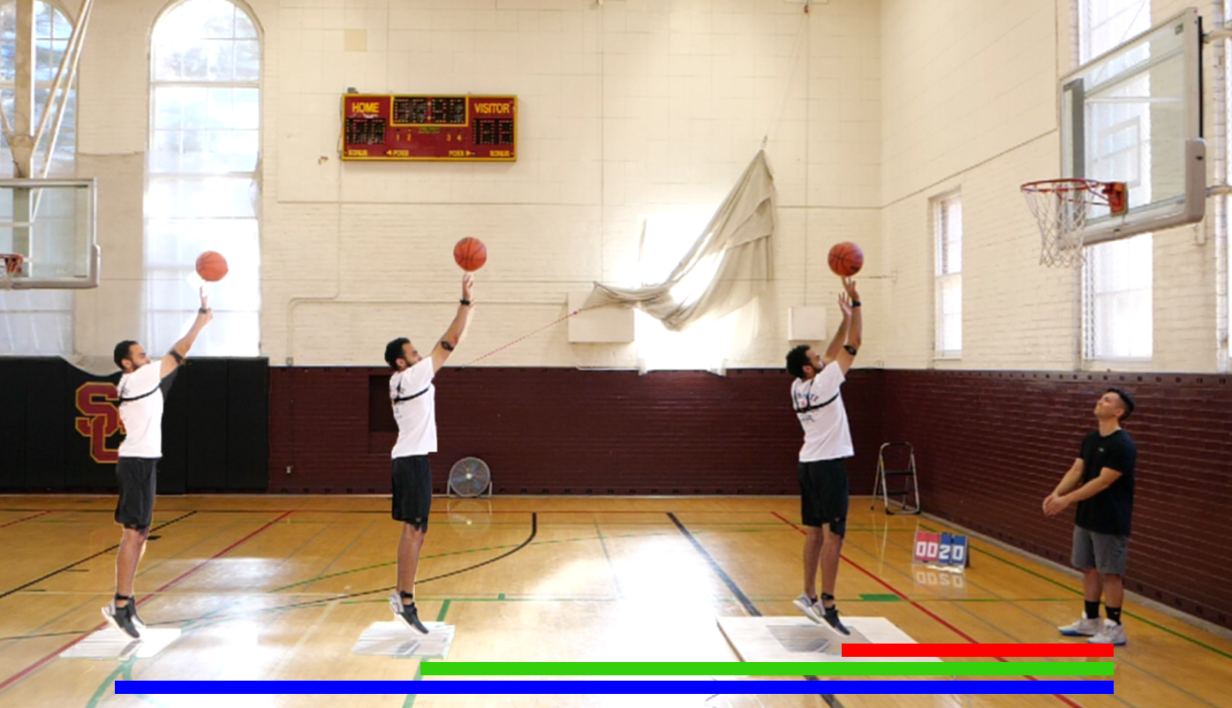
Methods
Participants
7 recreational players
4 female
College aged
Motion Capture
Ball motion
Panasonic, 120Hz
Two Force Plates
Net impulse
Kistler, 1200Hz

Slide 6
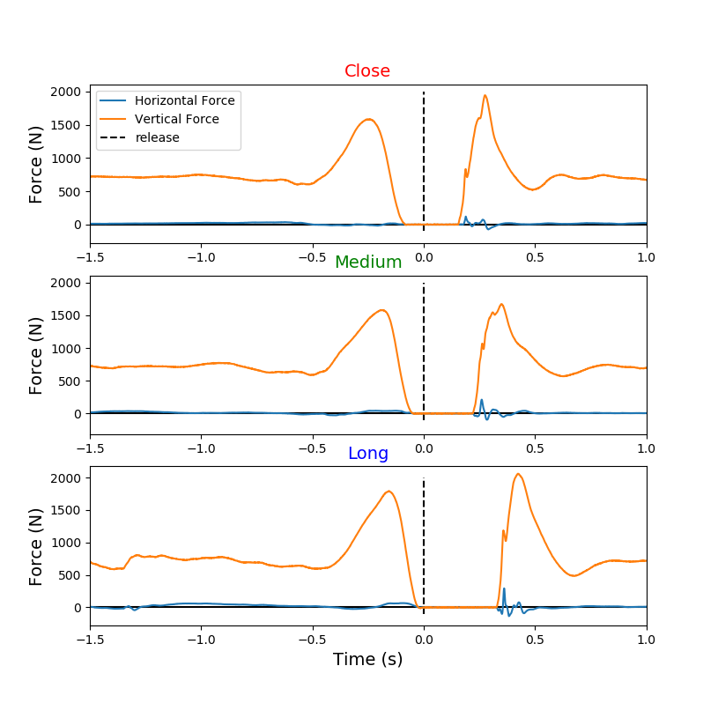
Methods - Variables: Center of Mass Velocity
Net Impulse
Integrate during shot prep
Time 1: Fz = BW +/- 10 N and Fx & Fy = +/- 30 N
Time 2: ball release
Velocity
Change in Velocity = Impulse
Assumed began at 0 m/s

Slide 7
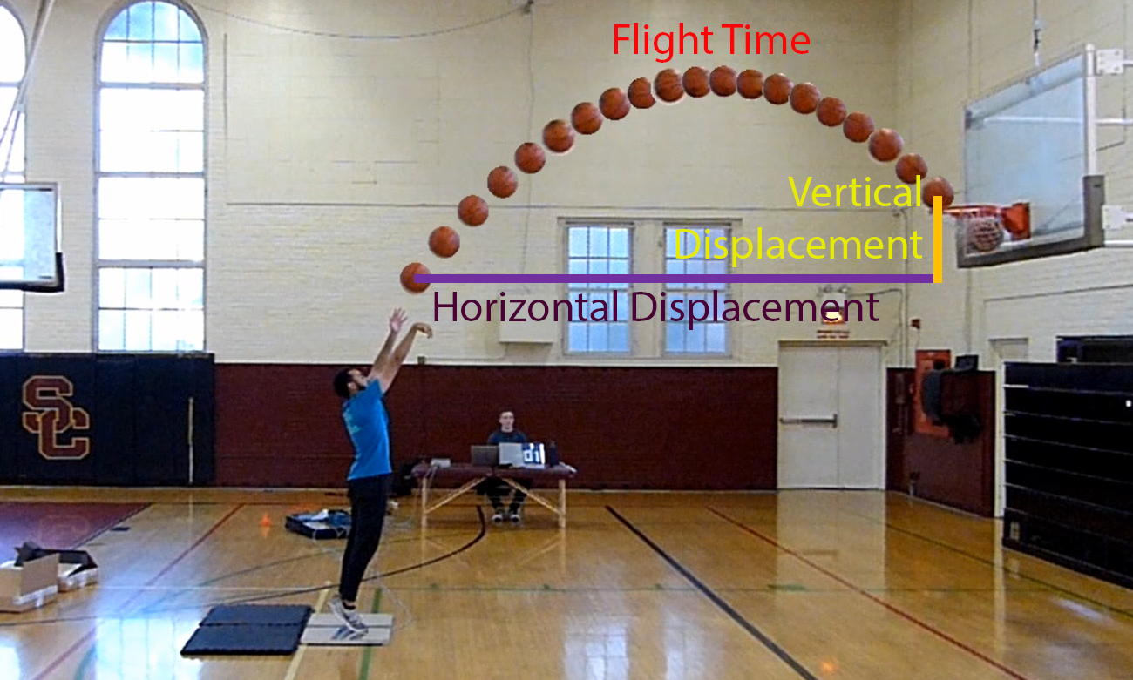
Methods - Variables: Ball Release Velocity

Slide 8
Does a Greater CM Velocity at Release Contribute More to Ball Velocity?

Slide 9
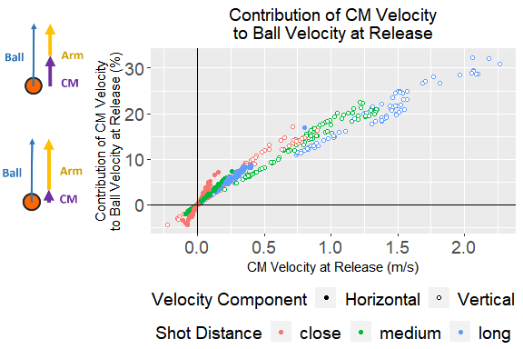
If You Have It, You Use It
A greater CM velocity at release decreases velocity contribution from the arms

Slide 10
How Can You Acheive a Greater CM Velocity?

Slide 11
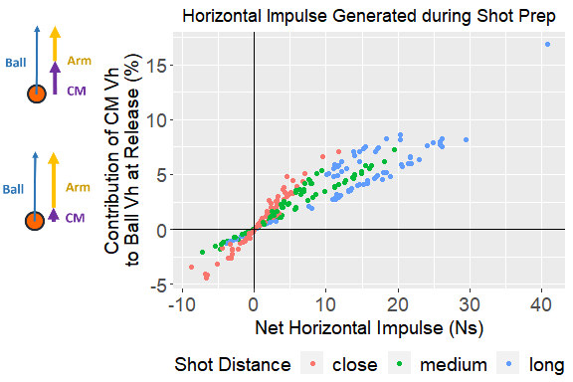
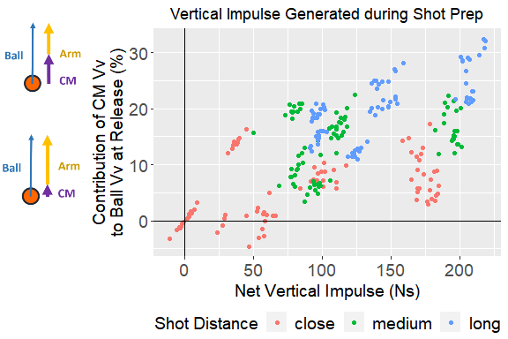
Generating Greater Impulse during Shot Prep Affords Greater Potential for CM Velocity at Release

Slide 12
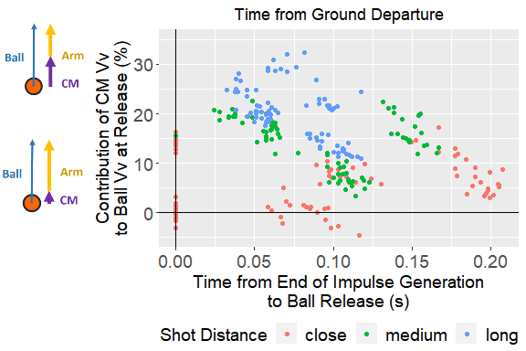
Time of Release Relative to End of Impulse May Not Give Full Picture

Slide 13
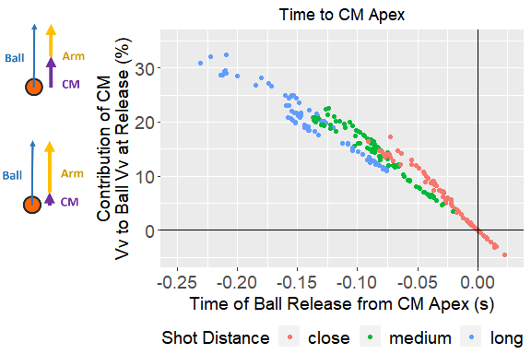
Time of Release Relative to Center of Mass Jump Apex is the Key Factor

Slide 14
Discussion
To increase CM velocity contribution:
increase impulse generated during contact phase
release ball earlier relative to jump center of mass apex
release time to apex may serve as better indicator than release time to ground departure
Future directions
Individual analyses
CM contributions on shooting accuracy
Effects of shooting while defended

Slide 15
Limitations
Method to Calculate Velocity
May not be at 0 m/s at initial
Not normal shooting mechanics - usually involves a step in
Small sample size
Population used in study

Slide 16
Future Steps Preview

Slide 17
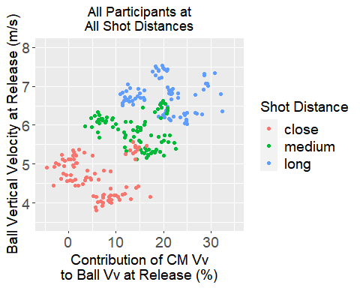
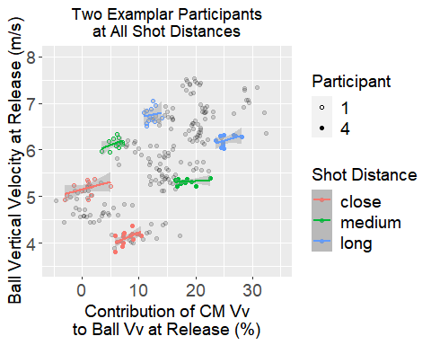
Individual Analyses

Slide 18
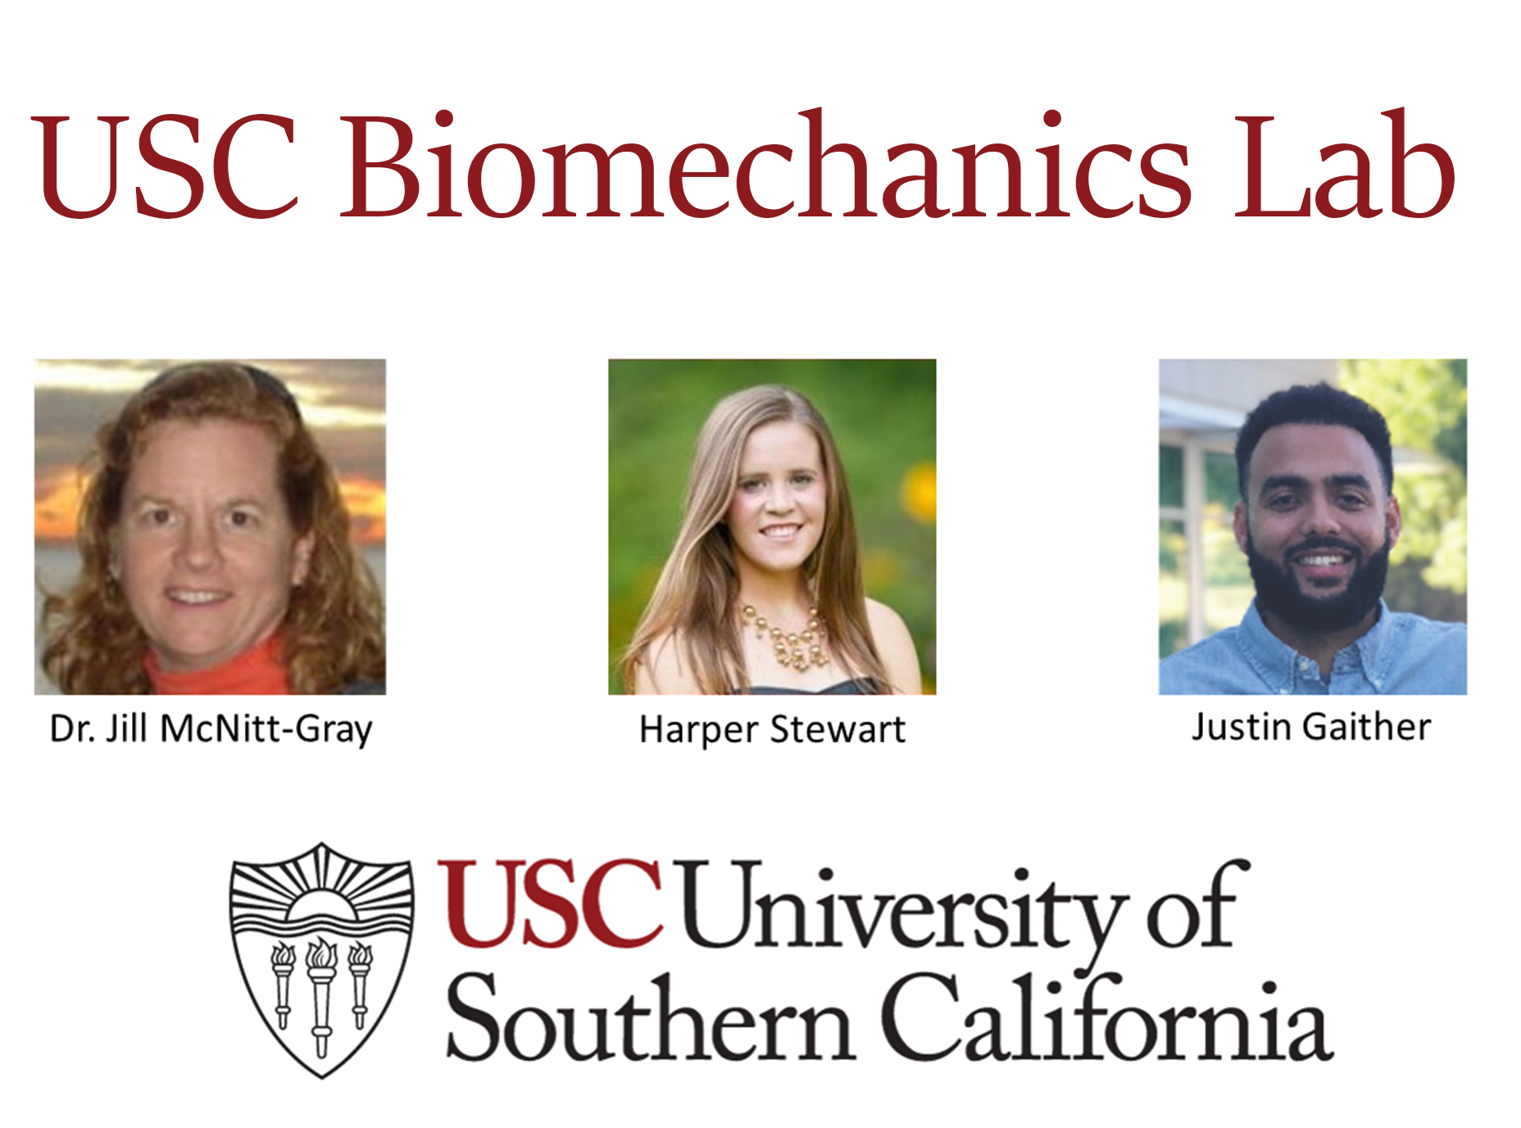
Acknowledgements

